Slide 1
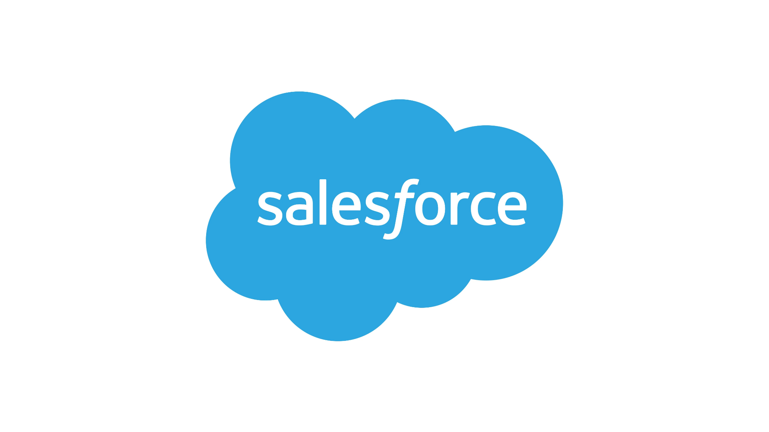







Resources
Sales Force
Terraform
IAM
Cloud Storage Buckets
Service Account
Storage Raw
Storage Bronze
Storage Silver
Storage Gold
Functions codebase
Prefect Logs
Scheduler
Orchestration trigger
BigQuery Datasets
Bronze
Silver
Gold
Cloud Functions 2nd Gen
Orchestration (with prefect)
ingestion
duckdb_query_to_parquet
bigquery_query_to_table
Looker Studio
POC Dashboard

Slide 2


Data flow
IAM
Scheduler
Sales Force
Service Account
Orchestration trigger
Orchestration function (with prefect)
Ingestion function
Ingestion pipeline
Duckdb query to parquet function
Raw_to_bronze pipeline
Bronze_to_silver pipeline
Silver_to_gold pipeline
Storage Raw
Storage Bronze
Storage Silver
Storage Gold
Functions codebase
Prefect Logs
Bronze
Silver
Gold
Looker Studio
POC Dashboard

Slide 3


Processing Architecture
Scheduler
Orchestration function
(with
Orchestration trigger
Trigger independent cloud function for each object ingested
Ingestion pipeline
Ingestion function
All trigger independent cloud functions for each transformation
Raw_to_bronze pipeline
Duckdb_query_to_parquet
Bronze_to_silver pipeline
Silver_to_gold pipeline
BigQuery_query_to_table
Not used at present, but created to allow to orchestrate pipelines run completely on BigQuery
Pros:
100% serveless
Pipelines written using Prefect framework and concepts
Intuitive way of structuring pipelines and tasks
Easy to define dependencies and run tasks that that don’t depend on each other in parallel.
Friendly logs and UI dashboard.
Independent and configurable processing units (each task run by its own compute).
Configuration allows to define individual instance capacity (from 0.167 to 8 cores, from128MB to 32GB memory, max processing time for single request 1h) and maximum number of instances active at any moment.
No proprietary technologies
Code could be ported to any other python running infrastructure easily
Written fully as Infrastructure-as-code (terraform) and deployed from one github repository
Cons:
Duck DB is considerably new
Prefect is considerably new
Prefect is being run without a stateful server, which requires some tooling to explore captured logs in the UI
Google Cloud Function 2nd Gen is considerably new

